Slide 1


Virtual Superpowers
Licence 2
Week 2

Slide 2
This Week’s Aim
To continue the Grammar revision
Present Perfect vs Present Perfect Continuous
Virtual Superpowers listening audio

Slide 3
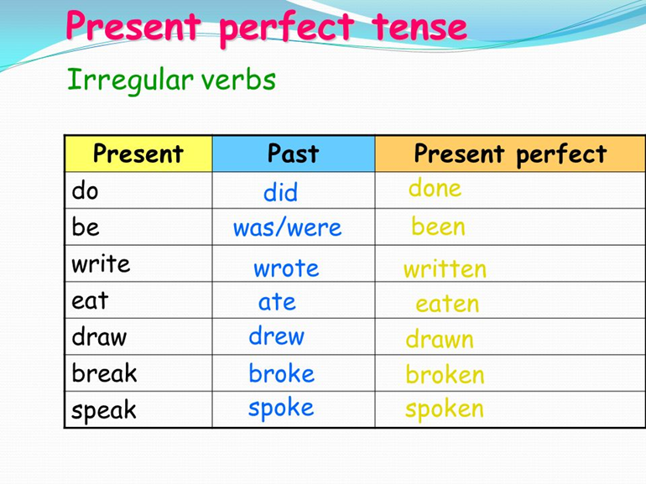
Present Perfect
Used to show a link between the present and the past
The time of action is in the past but not specified i.e. we don’t know when the action happened
Something that started in the past and continues into the present

Slide 4

Example:
Tom is looking for his key. He can’t find it. He has lost his keys.
He has lost his key recently, in the past, and he still doesn’t have it in the present

Slide 5
Construction: Affirmative
Subject: I / you / he / she / we / you (all) / they
+
Present simple of to have
+
Past participle / participle passé of second verb
E.g. I have slept

Slide 6
Note
Past participle DOES NOT always = simple past
To see → simple past = saw / past participle → seen
To do → simple past = did / past participle → done

Slide 7
Construction: Negative
Subject
+
Present simple of to have
+
Not
+
Past participle / participle passé of second verb
E.g. I have not/haven’t slept

Slide 8
Construction: Question
Present simple of to have reversed
+
Subject
+
Past participle / participle passé of second verb
Have you slept?

Slide 9
To Have: reversed
Have I
Have you
Has he / she / it + participe passé
Have we
Have you (all)
Have they

Slide 10
Just, Already and Yet
You can use the present perfect with just, already and yet.
just = a short time ago:
'Are you hungry?' 'No, I've just had lunch.’
‘Hello. Have you just arrived?
We use already to say that something happened sooner than expected: 'Don't forget to pay your electricity bill.' 'I've already paid it.’
'What time is Mark leaving?' 'He's already Left.'
Yet = until now. Yet shows that the speaker is expecting something to happen. Use yet only in questions and negative sentences: Has it stopped raining yet?
I've written the email, but I haven't sent it yet.

Slide 11
Exercise ☺
Read the situations and write sentences with just, already or yet.
Joe goes out. Five minutes later, the phone rings and the caller says, 'Can I speak to joe?’
You say: I'm afraid ____________________________________ (go out)
You are eating in a restaurant. The waiter thinks you have finished and starts to take your plate away. You say: Wait a minute! __________________________________. (not I finish)
You plan to eat at a restaurant tonight. You phoned to reserve a table. Later your friend says, 'Shall I phone to reserve a table?' You say: No,_________________________________________________________(do it)
You know that a friend of yours is looking for a place to live. Perhaps she has been successful. Ask her. You say: __________________ ? (find)
You are still thinking about where to go for your holiday. A friend asks, 'Where are you going for your holiday?' You say: _____________________ (not I decide)
Linda went shopping, but a few minutes ago she returned. Somebody asks, 'Is Linda still out shopping?' You say: No ______________________________________________(come back)

Slide 12
Answers ☺
Joe goes out. Five minutes later, the phone rings and the caller says, 'Can I speak to joe?’
You say: I'm afraid He has just gone out. (go out)
You are eating in a restaurant. The waiter thinks you have finished and starts to take your plate away. You say: Wait a minute! I haven’t finished yet. (not I finish)
You plan to eat at a restaurant tonight. You phoned to reserve a table. Later your friend says, 'Shall I phone to reserve a table?' You say: No, I have already done it(do it)
You know that a friend of yours is looking for a place to live. Perhaps she has been successful. Ask her. You say: Have you found a place to live yet? (find)
You are still thinking about where to go for your holiday. A friend asks, 'Where are you going for your holiday?' You say: I haven’t decided yet (not I decide)
Linda went shopping, but a few minutes ago she returned. Somebody asks, 'Is Linda still out shopping?' You say: No, she has just come back (come back)

Slide 13
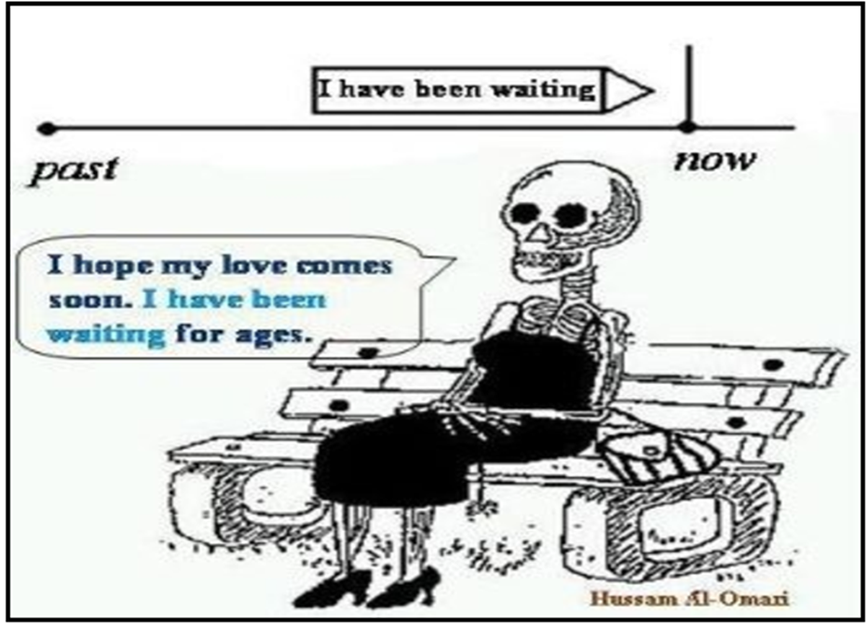
Present Perfect Continuous
Refresh → present perfect is used to show something that has started in the past and continues into the present
Present perfect continuous is used for an activity that has recently stopped or just stopped

Slide 14
Example:
Is it raining?
No, but the ground is wet.
It has been raining.

Slide 15
Present Perfect vs Present Perfect Continuous
Both tenses are used to express that an action began in the past and is still going on or has just finished
In many cases, both forms are correct, but there is often a difference in meaning
We use the Present Perfect mainly to express that an action is completed but the consequences of this action still affect the present
We use the Present Perfect Continuous to emphasise an action which is still going on into the present

Slide 16
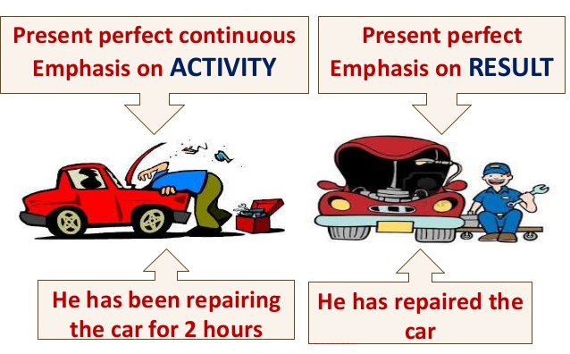
Example
Present perfect → I have written 5 letters
You are no longer writing the letters, but the result still affects your present
Present perfect continuous → I have been writing for an hour
You began writing in the past and are still writing at this moment in the present

Slide 17
Construction: Affirmative
Subject: I / you / we / you (all) / they
+
have
+
been
+ base verbal with ing
I have been doing / playing / waiting etc.

Slide 18
Or…
Subject: He / She / It
+
has
+
been
base verbale with ing
He has been doing / playing / waiting etc.

Slide 19
Construction: Negative
Subject: I / you / we / you (all) / they
+
have
+
NOT
+
been
+
base verbale with ing
I have NOT been doing / playing / waiting etc.

Slide 20
Or…
Subject: He / She / It
+
has
+
NOT
+
been
base verbale with ing
He has NOT been doing / playing / waiting etc.

Slide 21
Construction: Question
Have
+
Subject: I / you / we / you (all) / they
+
been
+
base verbale with ing
Have I been doing / playing / waiting? etc

Slide 22
Or…
Has
+
Subject: He / She / It
+
been
+
base verbale with ing
Has he been doing / playing / waiting etc. ?

Slide 23
Questions…
Read the situations and complete the sentences ☺
Maria _________________ English for two years. (to learn)
Hello, Tom. I _________________ for you. Where have you been? (to look)
Why _________________ (you/look) at me like that? Stop it!
Linda is a teacher. She _________________ for ten years. (to teach)
I _________________ about what you said and I’ve decided to take your advice. (to think)
Is Paul on holiday this week? No, he _________________ . (to work)
Chris _________________ well recently. (not / to feel)

Slide 24
Answers ☺
Maria has been learning English for two years.
Hello, Tom. I have been looking for you. Where have you been?
Why have you been looking at me like that? Stop it!
Linda is a teacher. She has been teaching for ten years.
I have been thinking about what you said and I’ve decided to take your advice.
Is Paul on holiday this week? No, he has been working.
Chris hasn’t been feeling well recently

Slide 25
Present Perfect or Present Perfect Continuous
Rachel is from Australia. She is travelling round Europe at the moment. She began her trip three months ago.
She _____________________________for three months. (travel)
_______________________________________six countries so far. (visit)
Patrick is a tennis player. He began playing tennis when he was ten years old. This year he won the national championship again- for the fourth time.
_____________________________________the national championship four times. (win)
________________________________________since he was ten. (play)
When they left college, Lisa and Sue started making films together. They still make films. They ________________________________films since they left college. (make)
__________________________________five films since they left college. (make)

Slide 26
Answers
She has been travelling for three months
She has visited six countries so far.
He has won the national championship 4 times.
He has been playing tennis since he was 10.
They have been making films since they left college
They have made five films since leaving college.

Slide 27
Listening Comprehension
Listen to the audio recording about ‘Virtual superpowers’ and answer the questions.

